Slide 1



Overview of the
Android System Services
Abolfazl Abbasi
Android Software Engineer

Slide 2
Why you should know this topic?
Write better code

Slide 3
Why you should know this topic?
Write better code
Learn Android OS Internals

Slide 4
Why you should know this topic?
Write better code
Learn Android OS Internals
Improve applications performance

Slide 5
Android System Architecture
System and 3th party Applications
API Framework
Native Library (C/C++, Rust)
Android Runtime
Hardware Abstract Layer (HAL)
Linux Kernel

Slide 6
Android System Architecture
System and 3th party Applications
API Framework
Native Library (C/C++, Rust)
Android Runtime
Hardware Abstract Layer (HAL)
Linux Kernel
Notes:
چطور اینجا کار میکنه؟

Slide 7
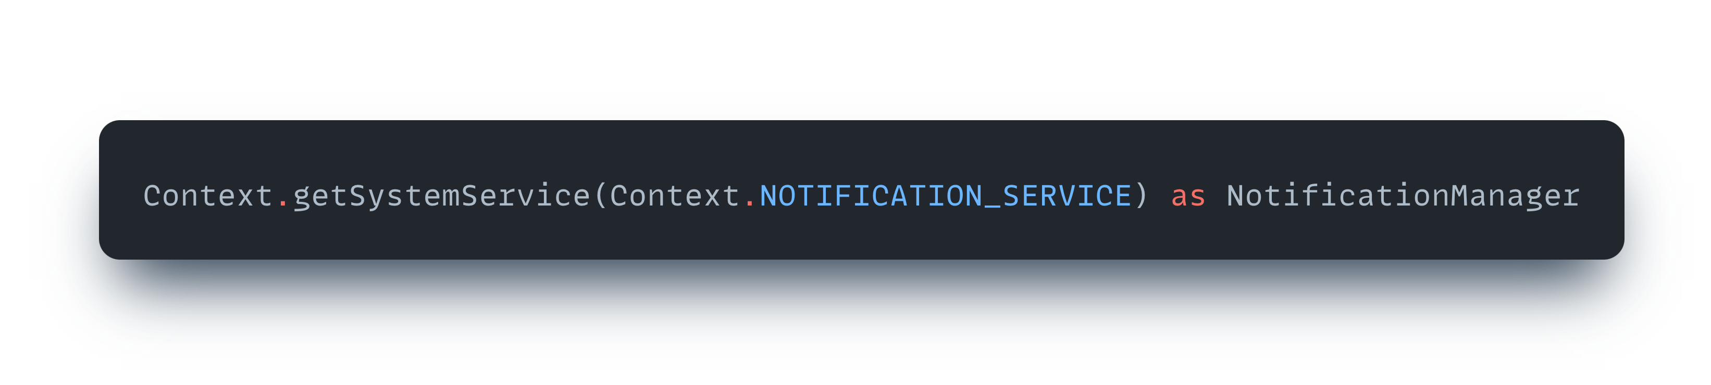
System Services
Notes:
NotificationManager
AlarmManager
LocationManager
InputManager

Slide 8
System Services
My Application
System Server
Service Manager
System Service
Notes:
این کلاس در حقیقت کاری نمیکنه!
سرویس و منیجیر
ایجکت منیجیر

Slide 9
System Services
My Application Process
System Service Process
My Application
System Server
Service Manager
System Service

Slide 10

System Services
Application Layer
Framework Layer
Kernel
GPS Hardware
My Application
System Server
Location Manager
System Service
Notes:
منیجیر در هر اپ

Slide 11
System Services
Application Layer
Framework Layer
Kernel
My Application
System Server
GPS Hardware
Location Manager
location Service
Google Map
Alarm Service
Location Manager
Power Manager Service
.
.
.
Telegram
.
.
.
Location Manager
Notes:
با یک سخت افزار چطور به همه خدمات میدهد؟
سینگل اینستنس

Slide 12
System Services and Managers

Slide 13
System Services and Managers
Application 1
Application 2
Notification Manager
Notification Manager
System Server
AIDL
Notification
System Service
AIDL
Application 3
Application 4
Notification Manager
Notification Manager

Slide 14
What’s happening under the hood?

Slide 15
System Services and Managers
My Application
System Server
Service Manager
System Service

Slide 16
System Service Through a Developer Lens

Slide 17
System Service Through a Developer Lens
System Service Registry
Context
Notification Manger
Location Manger
Context Impl
Power Manger
…
Notes:
هر چیزی کانتکسه
در مورد کش
لیزی لودر
پر کانتکس نات پر پر پروسس

Slide 18
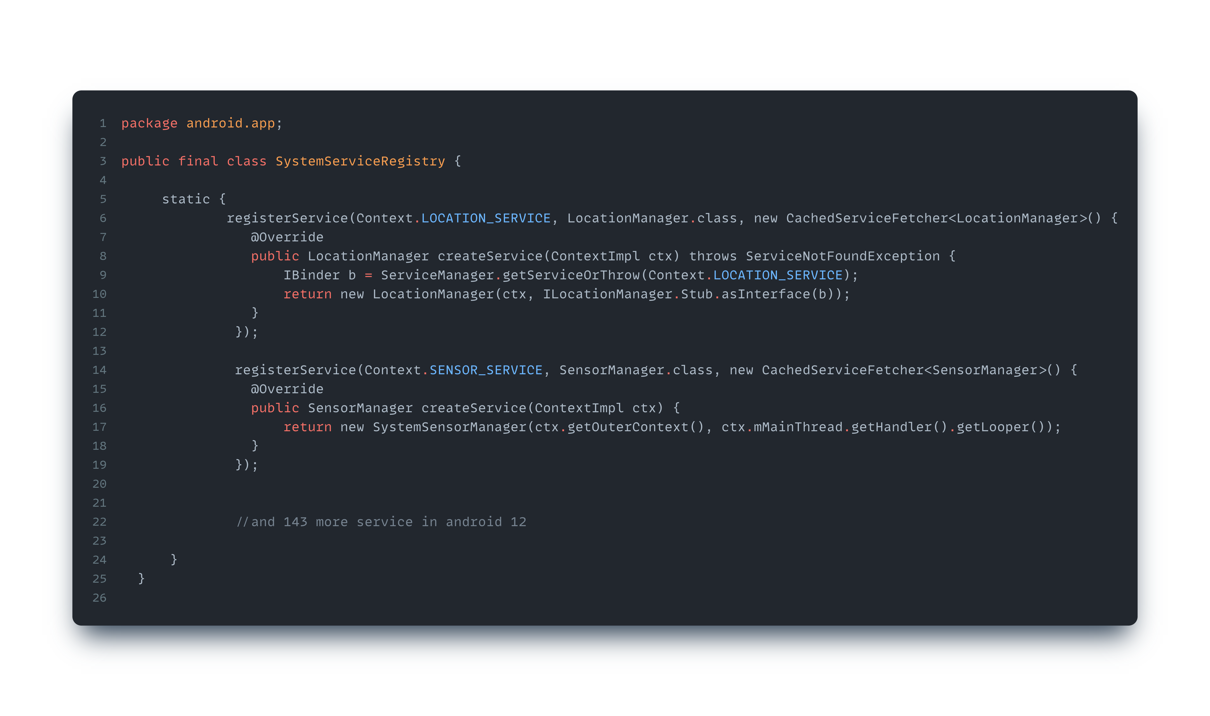
System Service Through a Developer Lens
Notes:
نحوه ی پیاده سازی رجیستری

Slide 19
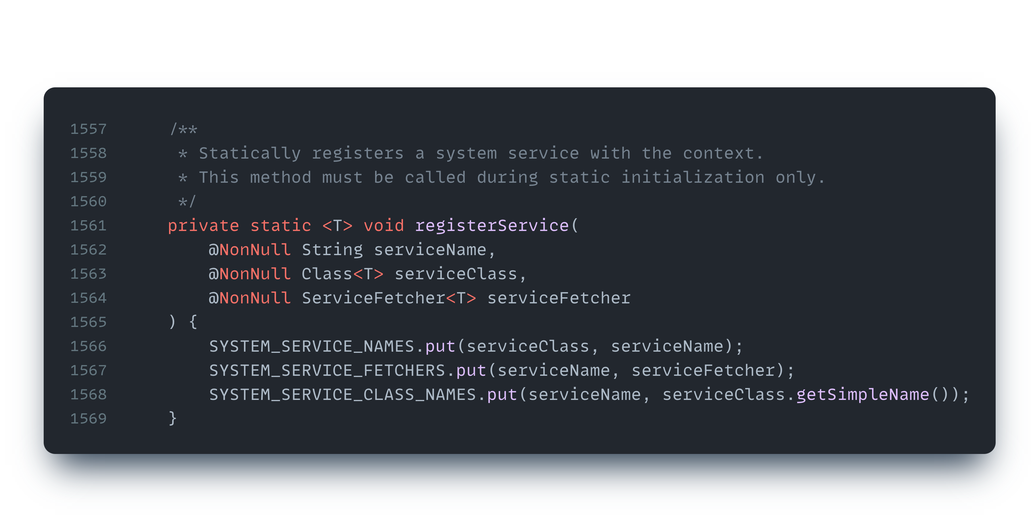
System Service Through a Developer Lens

Slide 20
Let's go just a little deeper for curiosity

Slide 21
Message Passing in System Services and Managers
My Application
System Server
Service Manager
System Service
Notes:
اول هم گفتم که اینا تو دوتا پروسس هستن

Slide 22
Message Passing in System Services and Managers
My Application
Binder
System Server
Service Manager
System Service
Notes:
نمیگم بایند چیه فقط یه بلک باکسه
اینتنت
رسیور
استارت اکتیویتی
سیستم سرویس
کمرا منجمنت

Slide 23
Message Passing in System Services and Managers
Application 1
Application 2
System Server
Service Manager
Service Manager
System Service
Kernel
Binder IPC
Notes:
AIDL

Slide 24
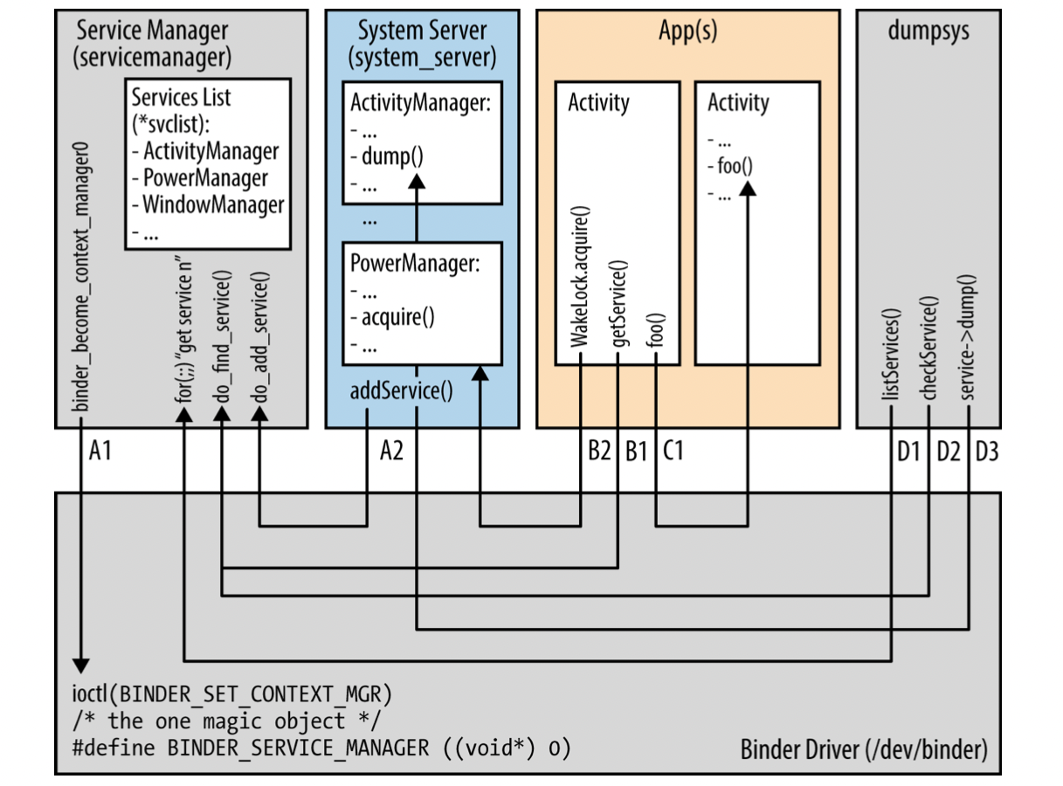
Message Passing in System Services and Managers
Notes:
انتها

Slide 25
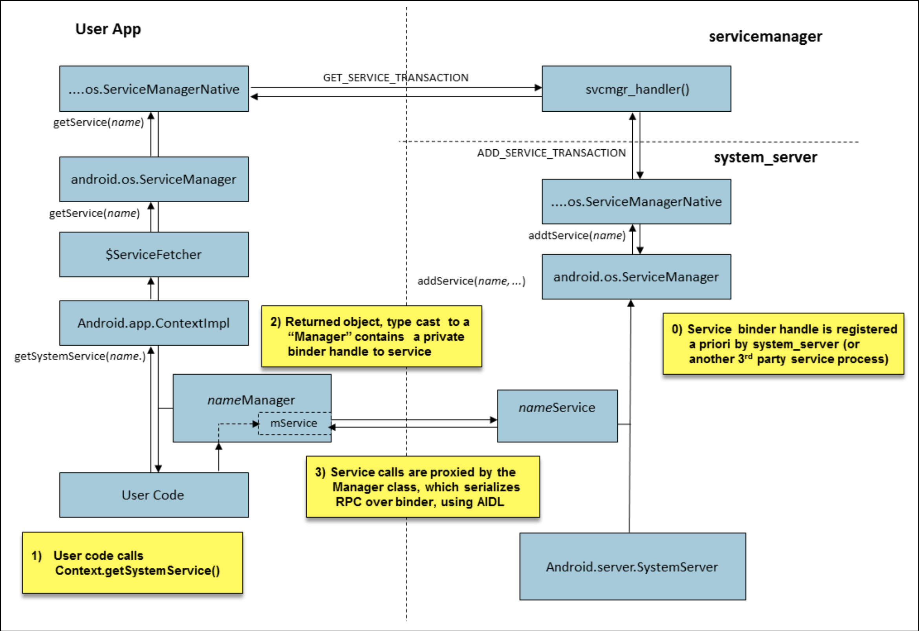

Android system service call pattern
Source: Android Internals - A Confectioner’s Cookbook
Notes:
انتها

Slide 26
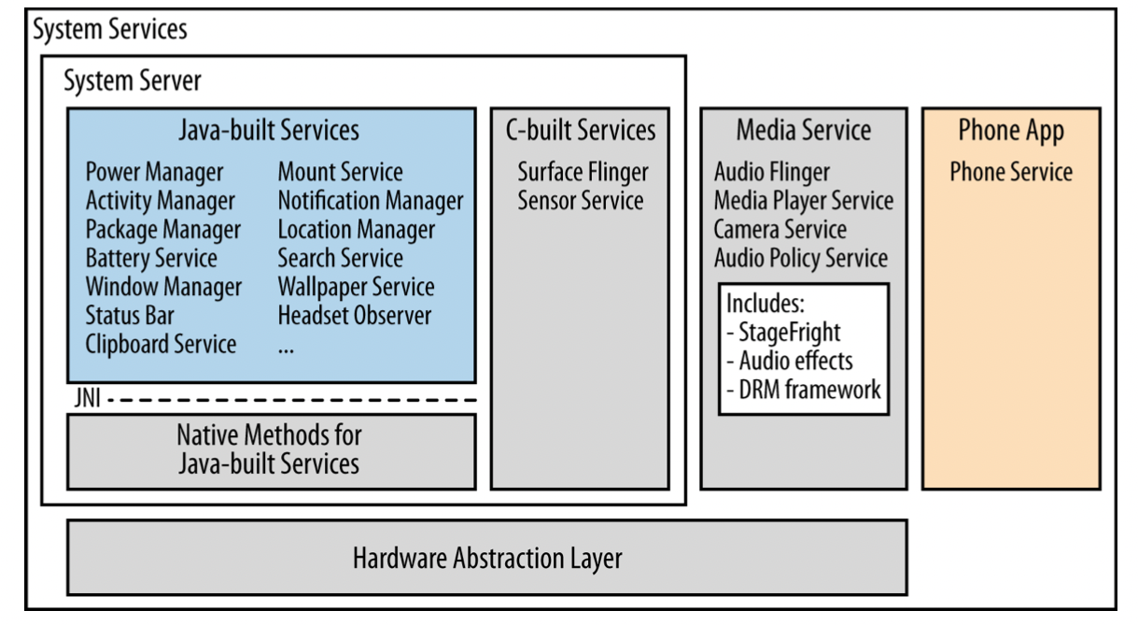
System Services and Managers
Notes:
پروسس ها
انتها

Slide 27
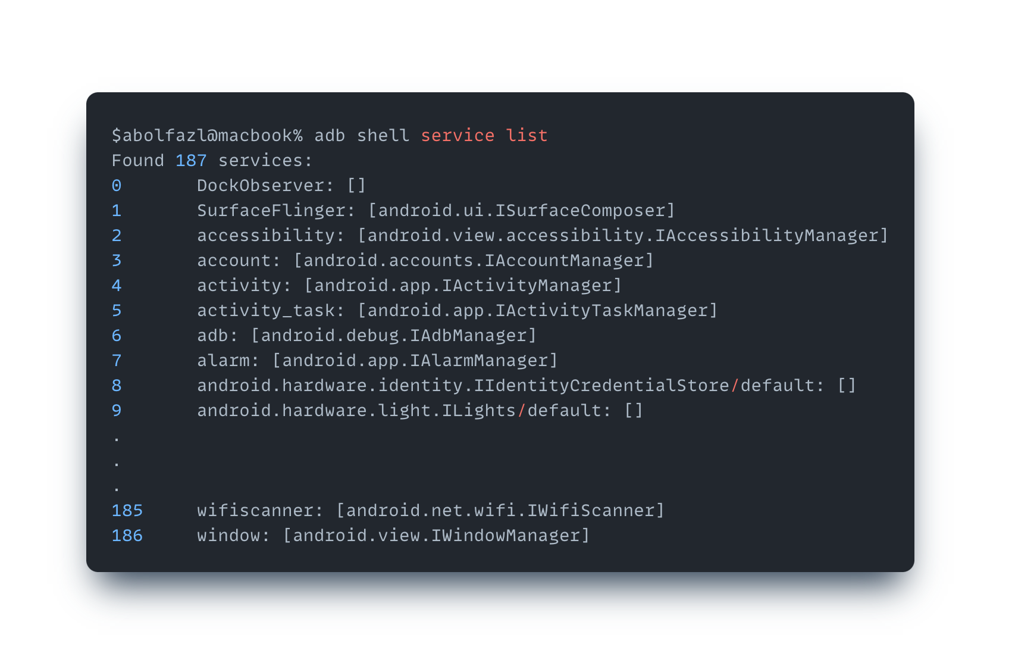
$ adb shell service list (google pixel4)

Slide 28
It's time to go to the application layer

Slide 29
System Service Through a Developer Lens
System Service Registry
Context
Notification Manger
Location Manger
Context Impl
Power Manger
…

Slide 30
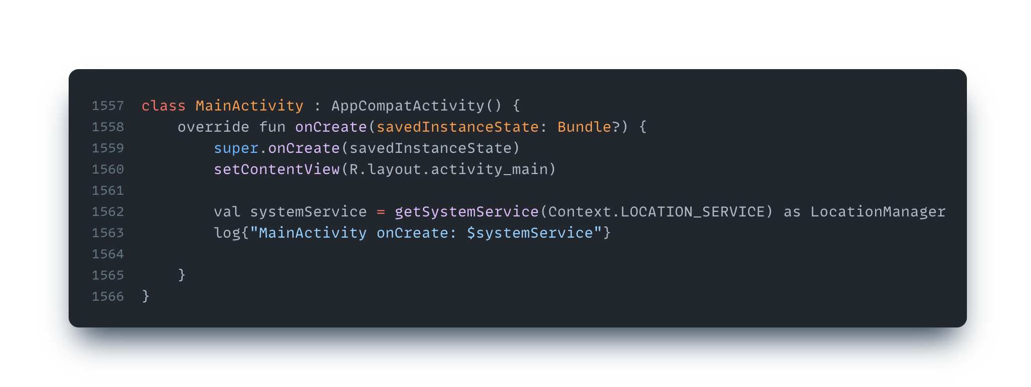
Manager caching

Slide 31
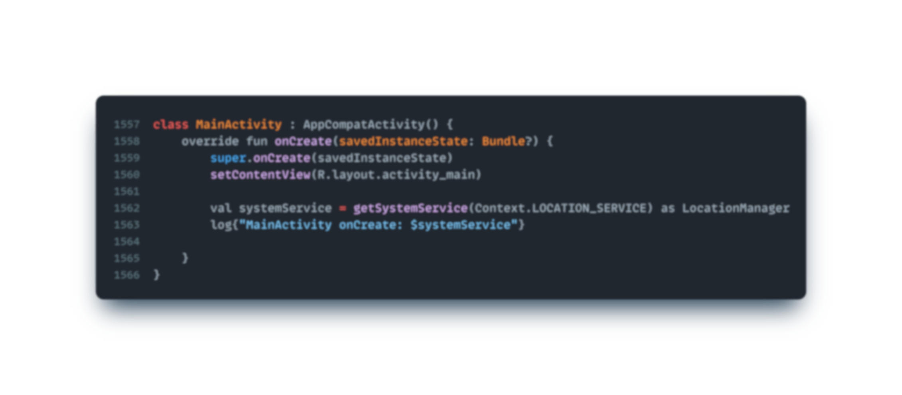
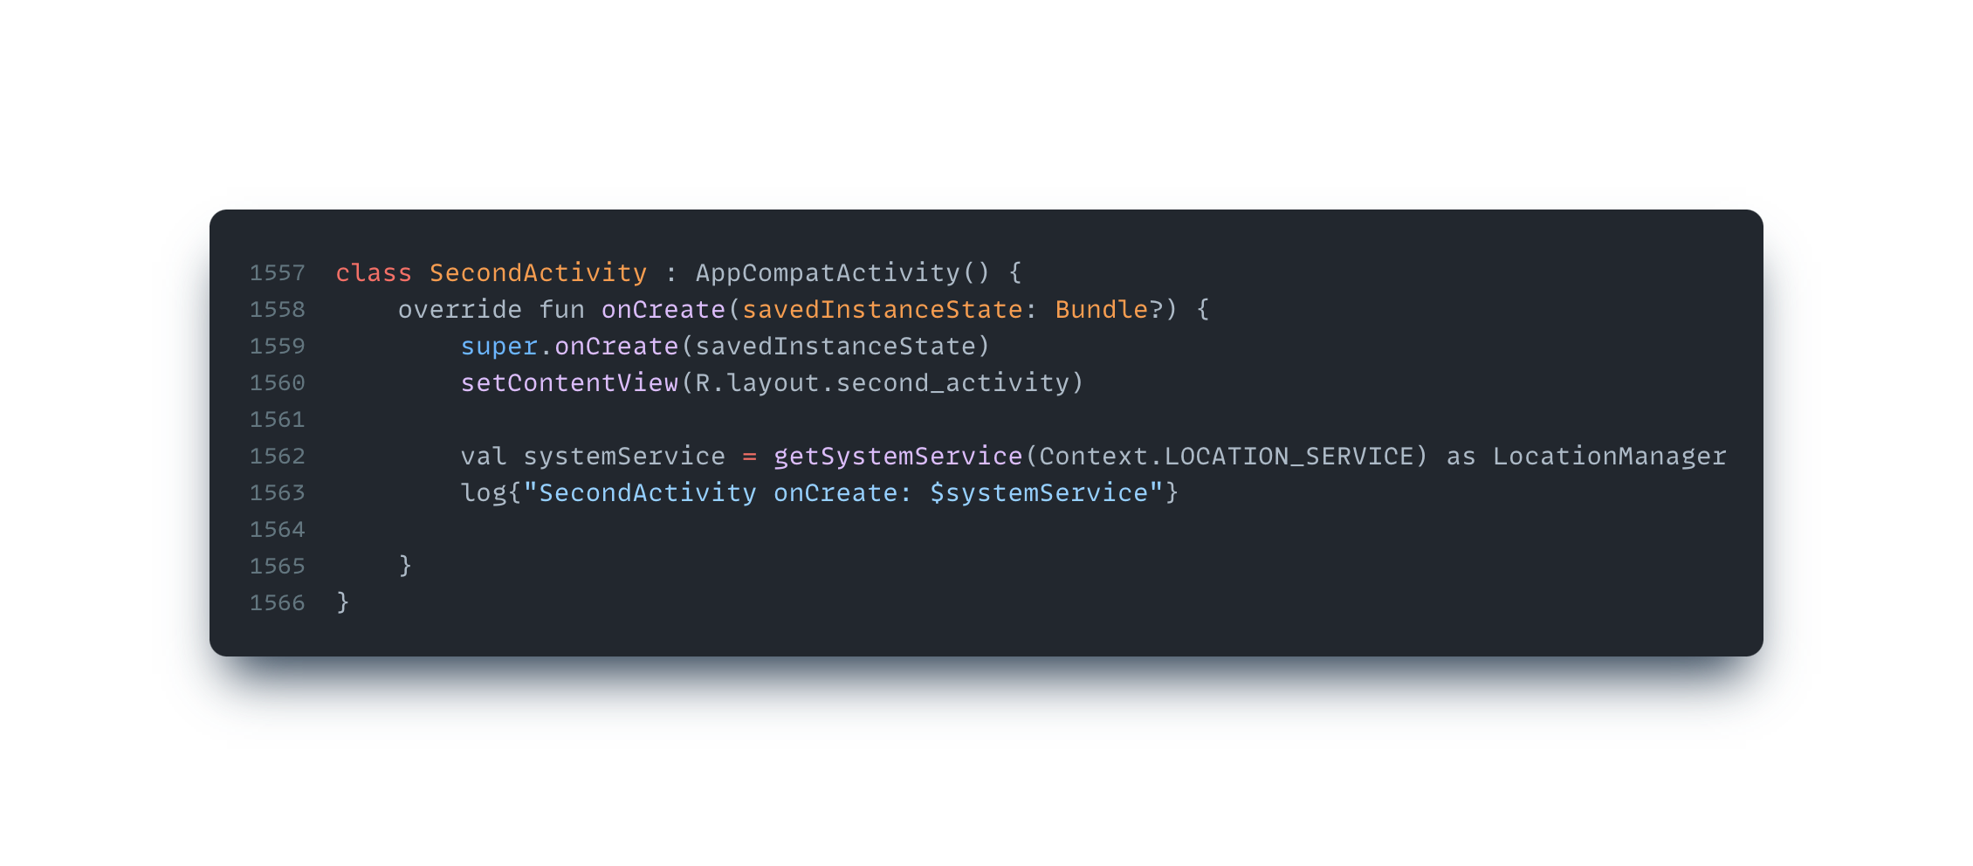
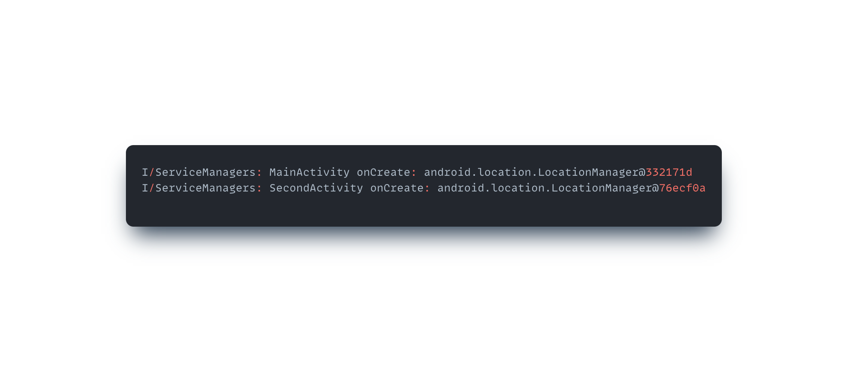
Manager caching

Slide 32
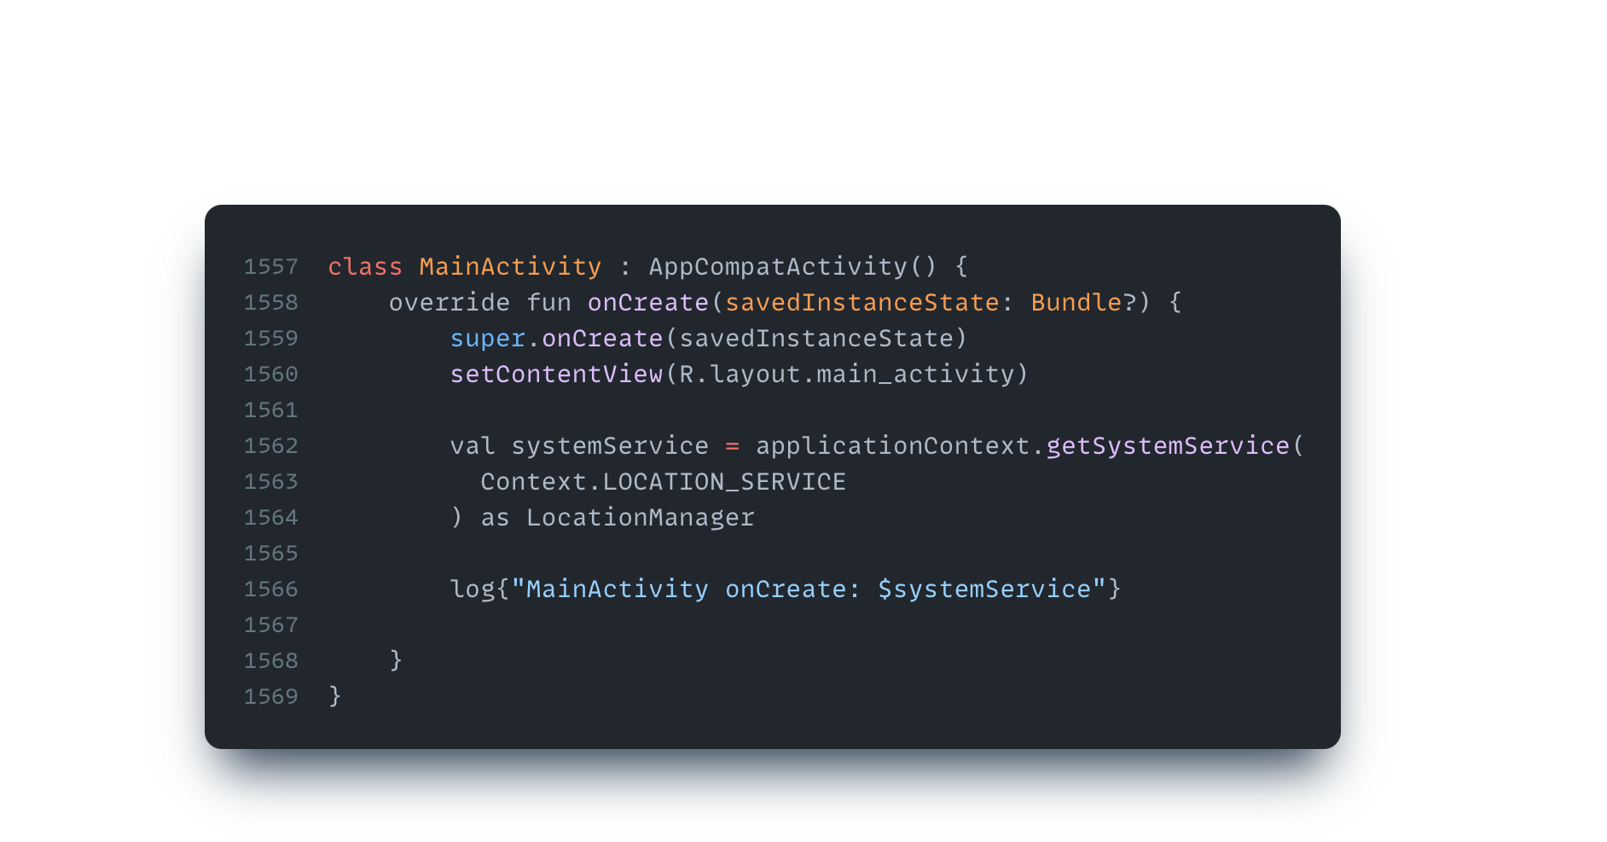
Manager caching using Application Context

Slide 33
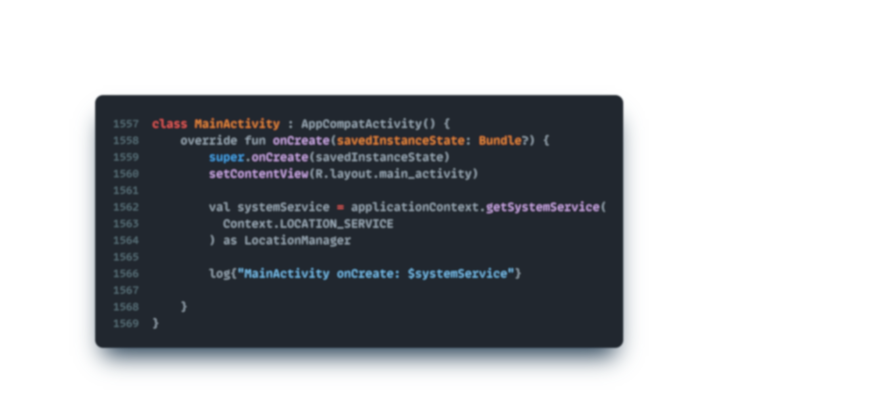


Manager caching using Application Context

Slide 34
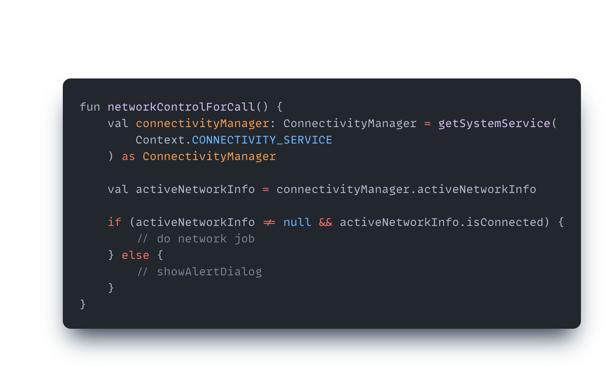
Memory Leak Example

Slide 35
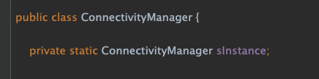
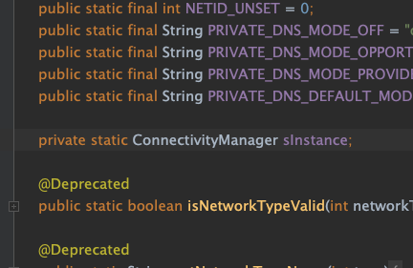
Memory Leak Example

Slide 36
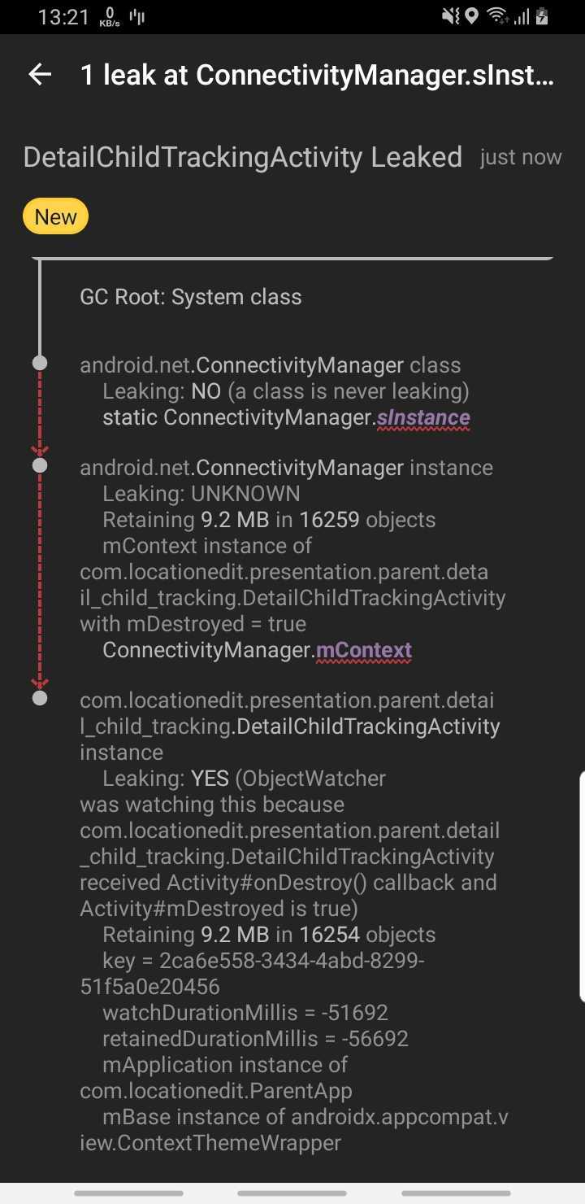
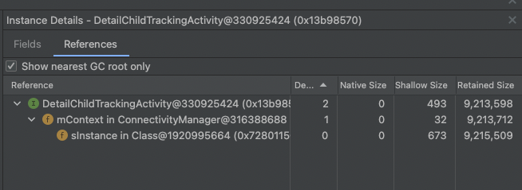
Memory Leak Example

Slide 37
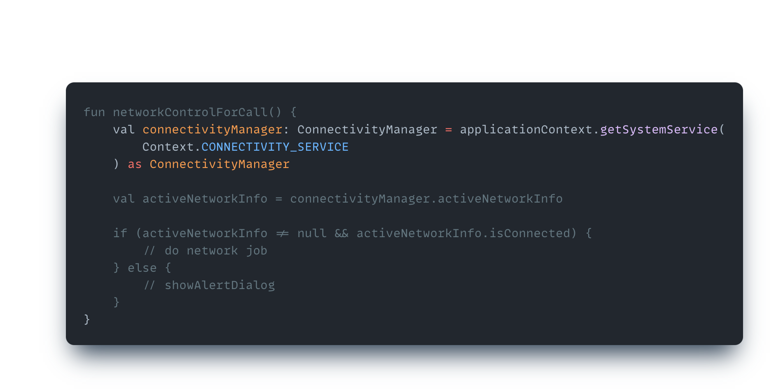
Memory Leak Example

Slide 38
Memory Leak Example

Slide 39
GC and Strong Reference
My Application
System Server
Service Manager
System Service
Kernel
Binder IPC

Slide 40
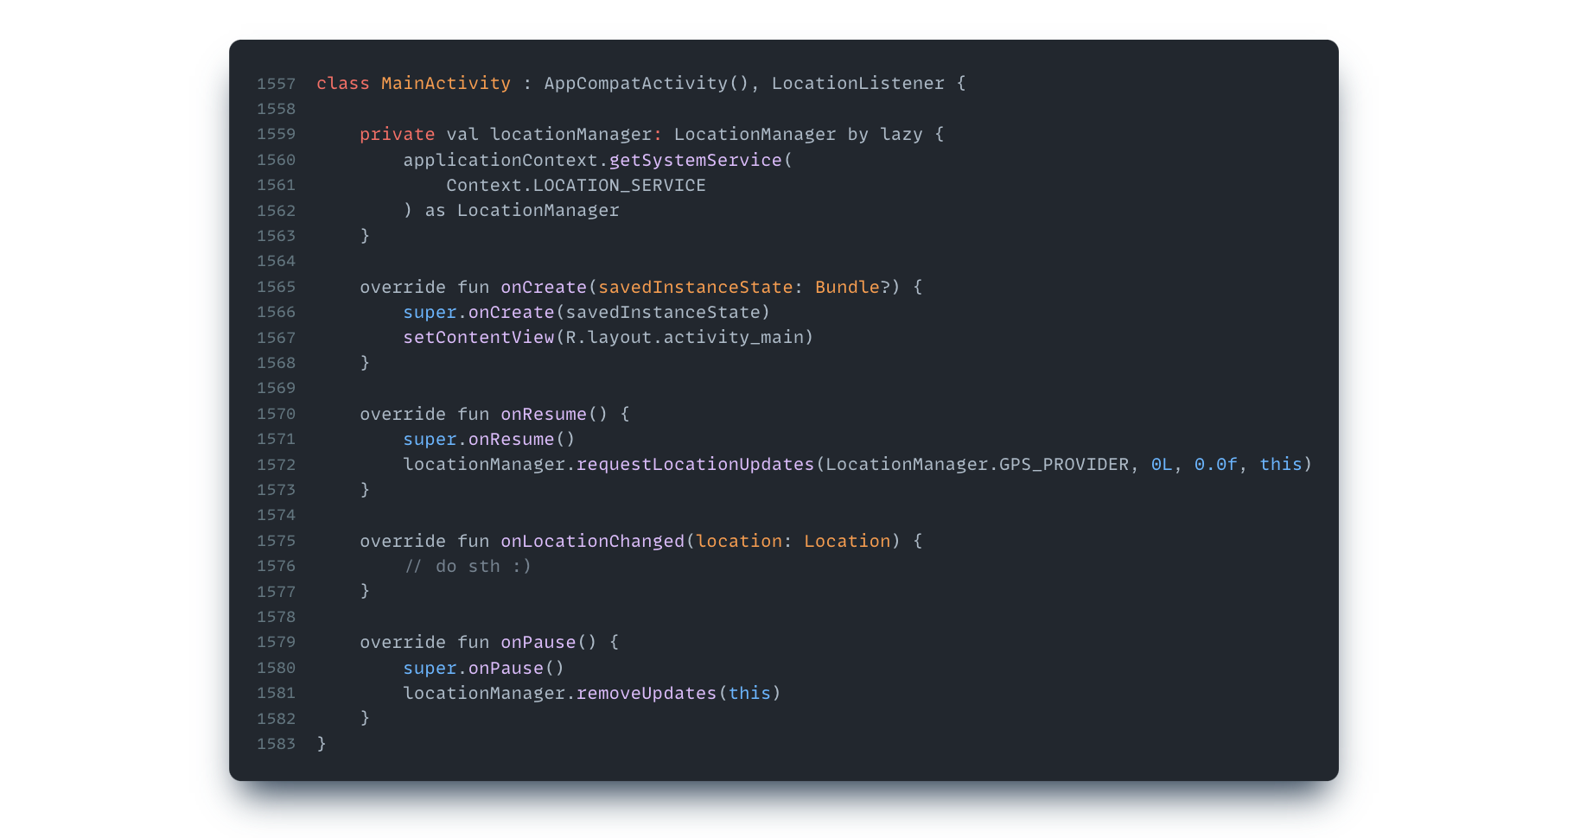
Using Location Manager Listener

Slide 41
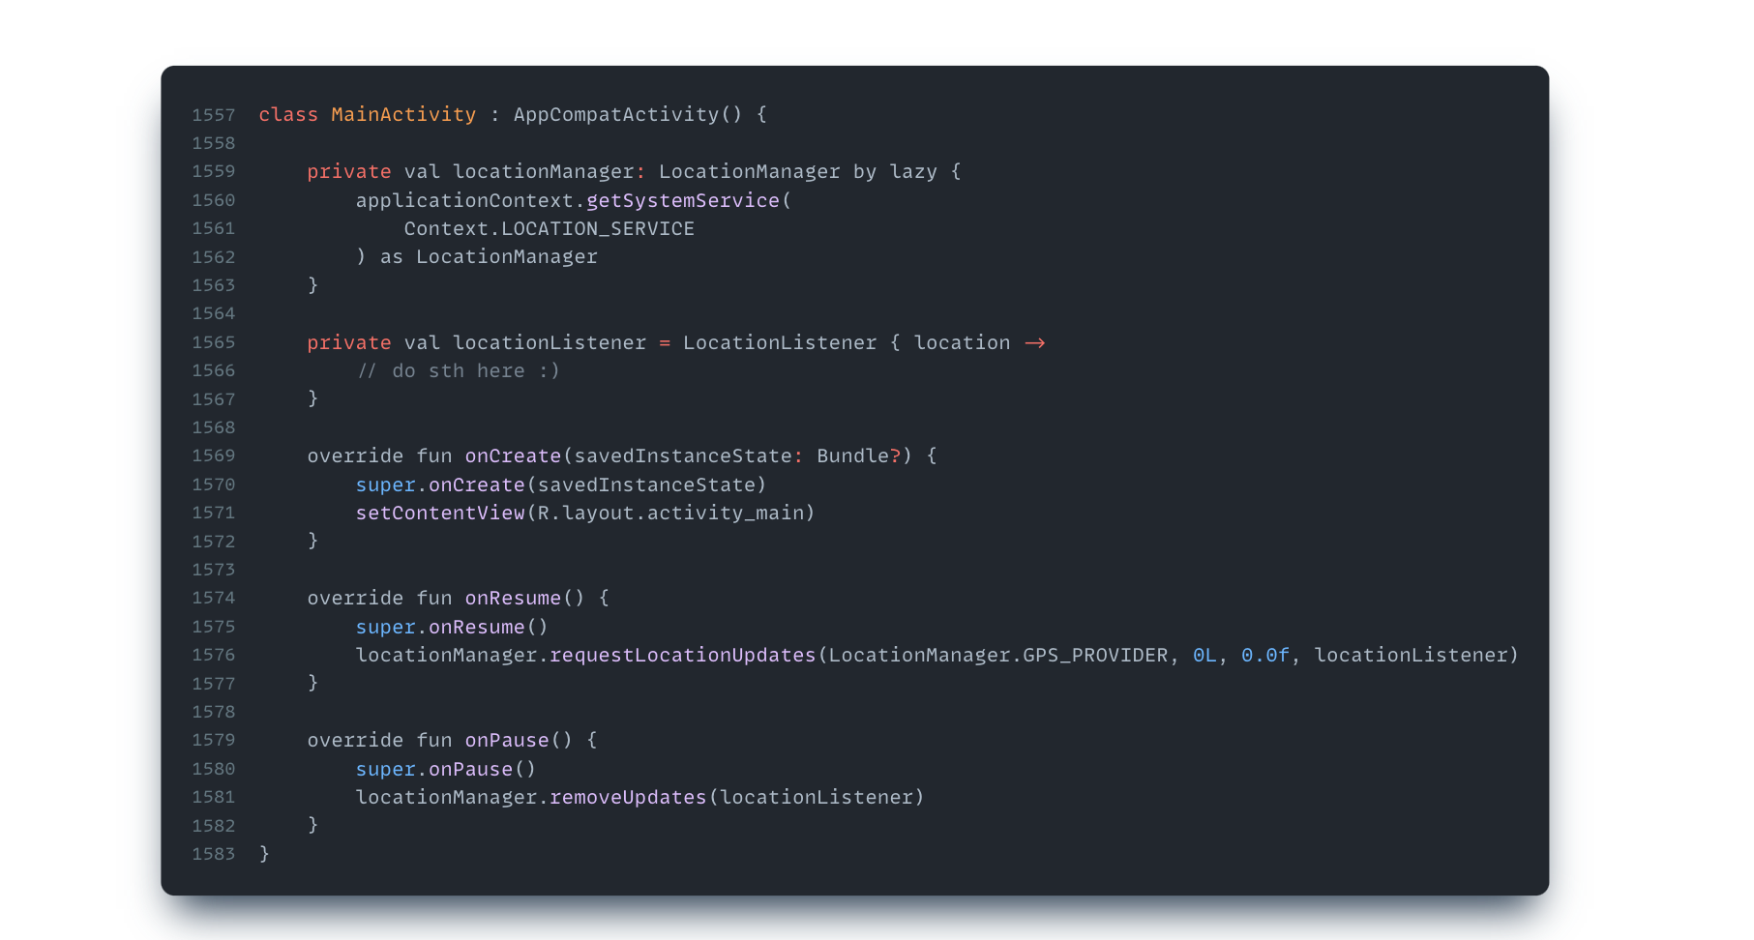
Using Location Manager Listener

Slide 42
Using Location Manager Listener

Slide 43
Using Location Manager Listener

Slide 44
Conclusion:
Managers are cashed per context not per process

Slide 45
Conclusion:
Managers are cashed per context not per process
Every Service has only a single instance in the Service process

Slide 46
Conclusion:
Managers are cashed per context not per process
Every Service has only a single instance in the Service process
System Service works in different process than your App process

Slide 47
Conclusion:
Managers are cashed per context not per process
Every Service has only a single instance in the Service process
System Service works in different process than your App process
Kernel Binder driver handles IPC and RPC in the Android OS

Slide 48
Conclusion:
Managers are cashed per context not per process
Every Service has only a single instance in the Service process
System Service works in different process than your App process
Kernel Binder driver handles IPC and RPC in the Android OS
Use ApplicationContext for access to the system services manager

Slide 49
Conclusion:
Managers are cashed per context not per process
Every Service has only a single instance in the Service process
System Service works in different process than your App process
Kernel Binder driver handles IPC and RPC in the Android OS
Use ApplicationContext for access to the system services manager
Don’t pass Long Running Instance as a call back to managers

Slide 50


Resources:
Digging Into Android System
Services by Dave Smith

Slide 51


Teşekkürler
Abolfazl Abbasi
Android Software Engineer Mail: abbasiabolfazlIT@gmail.com
Twitter: @abbasiabolfazl
GitHub: @aabolfazl

